Slide 1
DRIVING FORCES - TRAINING
rev Jan 2023

Slide 2
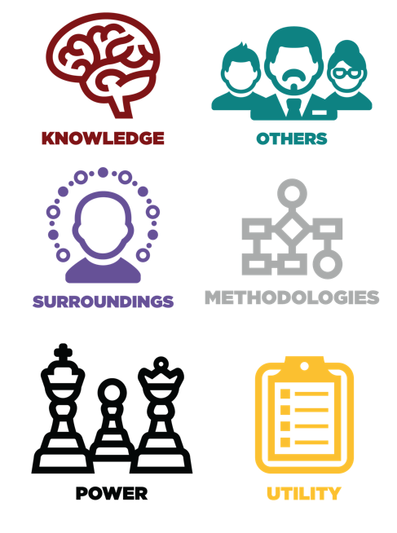
DRIVING FORCES
There are 6 Motivator Types.
Subdivided in 12 Driving Forces.
They are the key to understanding engagement and fulfillment.

Slide 3
Motivator Types
How a person values knowledge, learning and discovery.
How the beauty and form in a person’s surroundings impact and influence their experience.
How a person values individuality, status, renown and person influence.
How a person values practicality, usefulness and gaining a return on all investments of time, talent and resources.
How a person values giving, being of service and helping others.
How a person values meaningful and defined systems that align with their personal beliefs.

Slide 4
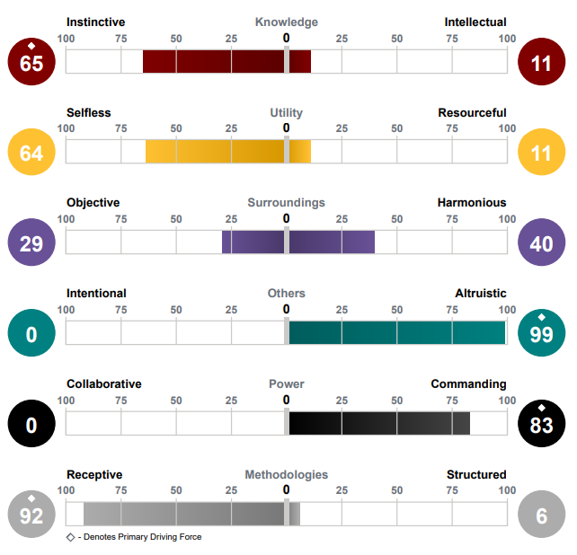

Slide 5
Driving Forces Clusters
Primary Drivers:
Top 4 Driving Forces.
Key factors that move you into action and influence your decisions.
Situational Drivers:
Middle 4 Driving Forces.
May come into play situationally.
Indifferent Drivers:
Last 4 Driving Forces.
May cause an adverse reaction when interaction with people or tasks focus on one or more of these drivers.

Slide 6
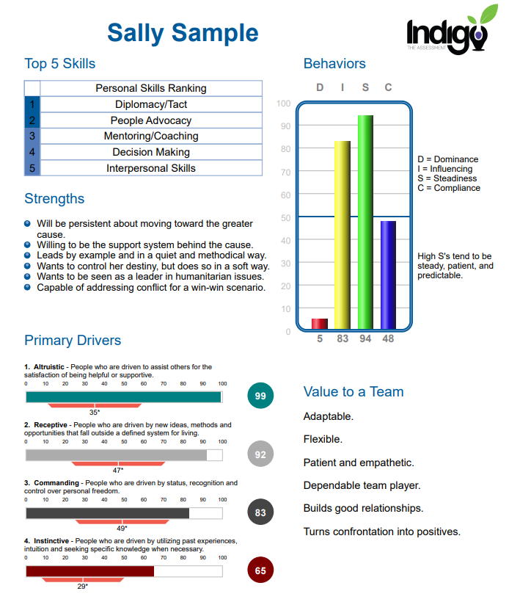

Slide 7
Driving Forces and Work Engagement
The key to fulfillment and engagement in the workplace is found in the Primary Drivers.
When most or all 4 are filled/fulfilled, people are engaged in and enjoy their work.
Consider – company mission, role within the organization, etc.

Slide 8
INSTINCTIVE
<<
INTELLECTUAL >>
Driven by utilizing past experiences, intuition and seeking specific knowledge when necessary.
Value knowledge that serves their specific purpose.
Driven by opportunities to learn, acquire knowledge, and discovery of the truth.
Value knowledge for the sake of knowledge.
This motivator continuum focuses on Knowledge.
How a person values knowledge, learning and discovery.
How we gather and use information.

Slide 9
SELFLESS
<<
RESOURCEFUL
>>
Driven by completing tasks for the sake of completion, with little expectation of personal return.
They see the task itself and its completion as valuable.
Driven by practical results, maximizing both efficiency and returns on investments of time, talent, energy and resources.
They see their time as incredibly valuable and don’t like to waste their time.
This motivator continuum focus on Utility.
How a person values practicality, usefulness and gaining a return on all investments of time, talent and resources.
How a person values tasks and their practicality.

Slide 10
OBJECTIVE
<<
HARMONIOUS
>>
Driven by the functionality and objectivity of their surroundings.
They can thrive in an environment filled with chaos.
They create for function not beauty.
Driven by the experience, subjective viewpoints and balance in their surroundings.
They strive to create balance and harmony in their environment and relationships.
They often have some sort of creative self expression.
This motivator continuum focuses on Surroundings.
How the beauty, form and function in their surroundings impact and influence their experience.
How the environment affects them.

Slide 11
INTENTIONAL <<
ALTRUISTIC
>>
Driven to assist others for a specific purpose, not just for the sake of being helpful or supportive.
They often feel a sense of purpose and drive, which typically isn’t people/other focused.
Driven to assist others for the satisfaction of being helpful and supportive.
They often have a cause – a problem in the world they want to help solve, a group they want to help or serve.
This motivator continuum focuses on Others –
How a person values giving and/or being of service to others.
How a person values helping for the sake of helping.

Slide 12
COLLABORATIVE
<<
COMMANDING
>>
Driven by being in a supportive role and contributing with little need for individual recognition.
They desire collective achievement and value being “a part of the whole.”
Driven by status, recognition and control over personal freedom.
They want to be seen as a leader and recognized for their accomplishments.
This motivator continuum focuses on Power –
How a person values individuality, choice and personal influence.
How a person values renown and recognition.

Slide 13
RECEPTIVE
<<
STRUCTURED
>>
Driven by new ideas, methods and opportunities that fall outside of a defined system.
They often see the world as a blank slate from which they can create a desired outcome.
Driven by traditional approaches, proven methods and a well-defined system.
They often have a set of values or beliefs that create the lens through which they make decisions.
This motivator continuum focuses on Methodologies –
How a person values and approaches existing structures and systems.
How a person values meaningful and defined systems that align with their personal beliefs.

Slide 14
Reflection based application
Questions you can present to students for discussion and reflection in class or online.
Your Motivator Statement- Using your Primary Drivers, how would you describe what is most important to you, what you are all about, what drives you or what’s your purpose?
Differing Drivers - Which drivers are most difficult for you to connect with? How might you understand or value this driver differently now that you know more about it?
Drivers in the workplace – Brainstorm to create a list of examples of companies, organization, jobs or famous people that would be fulfilling to each driver.

Slide 15
Contact Information
www.IndigoEducationCompany.com
sueann.casey@indigoproject.org
www.linkedin.com/in/sueann-casey-indigo
509-435-5903

Slide 17
Driving Forces Graph
Primary Drivers
1. Altruistic
2. Receptive
3. Commanding
4. Instinctive

Slide 18
Driving Forces – Motivators
THEORETICAL
AESTHETIC
INDIVIDUALISTIC
KNOWLEDGE: INSTINCTIVE OR INTELLECTUAL
SURROUNDINGS: OBJECTIVE OR HARMONIOUS
POWER: COLLABORATIVE OR COMMANDING
UTILITARIAN
SOCIAL
TRADITIONAL
UTILITY: SELFLESS OR RESOURCEFUL
OTHERS: INTENTIONAL OR ALTRUISTIC
METHODOLOGIES: RECEPTIVE OR STRUCTURED

Slide 19
