Slide 1
Indigo Report Debrief
rev Jan 2023

Slide 2
INDIGO AND TRIMETRIX
Our technology partner, Target Training International (TTI), has been researching and validating assessment technologies for over 35 years.
Partnership: the questionnaire/assessment (TTI) the report (Indigo)
Components:
DISC: Measures how a person does what they do.
Driving Forces: Describes why a person does what they do.
Competencies: Show what someone does, what skills they have developed.

Slide 3
INDIGO VALIDITY & RELIABILITY
Indigo uses a validated multi-factor assessment combining multiple sciences to measure behaviors, motivators, and skills. Indigo is available for grades 6-adults.
The most comprehensive assessment tool on the market, currently used extensively in the corporate world (90 countries and 40 languages).
The Indigo Assessment is EEOC, OFCCP, and FERPA compliant. There are no adverse impacts for socio-economic class, race, gender, or disability.

Slide 4
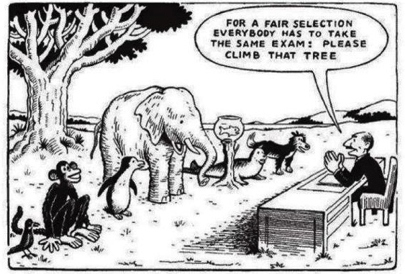
Self-awareness as the foundation
WHY USE ASSESSMENTS?

Slide 5
Behavioral/ Communication Style. Understand your own style and that of others.

Slide 6
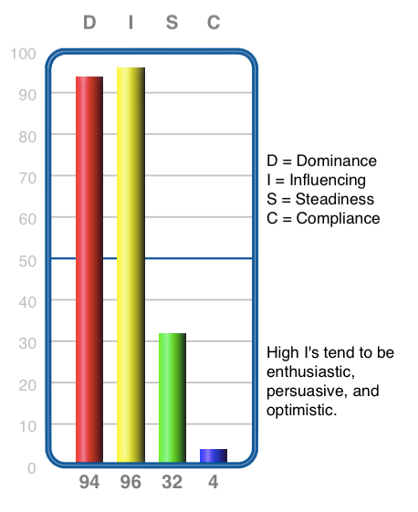
DISC
High
DISC describes our unique behavioral makeup.
No “right” or “wrong” score or combination.
8 distinct styles
It’s observable.
DISC is the key to successful communication.
It describes our ideal work environment.
Energy Line
Low

Slide 7
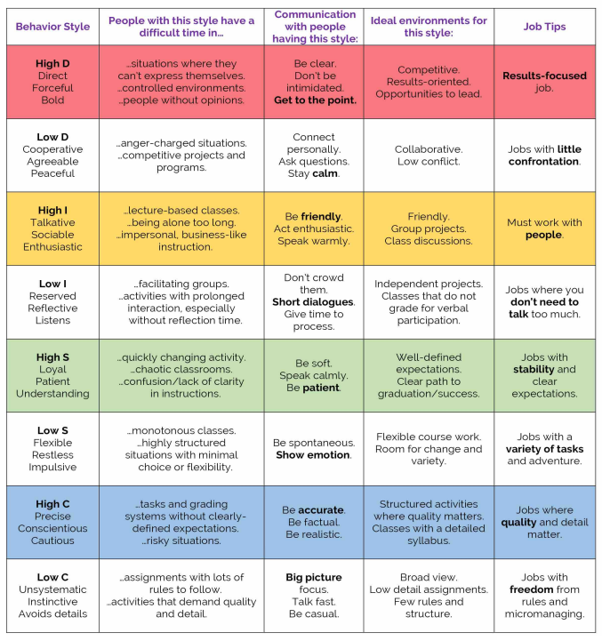

Slide 8
Primary Drivers are critical for engagement and personal fulfillment.

Slide 9
Motivator Types
How a person values knowledge, learning and discovery.
How the beauty and form in a person’s surroundings impact and influence their experience.
How a person values individuality, status, renown and person influence.
How a person values practicality, usefulness and gaining a return on all investments of time, talent and resources.
How a person values giving, being of service and helping others.
How a person values meaningful and defined systems that align with their personal beliefs.

Slide 10
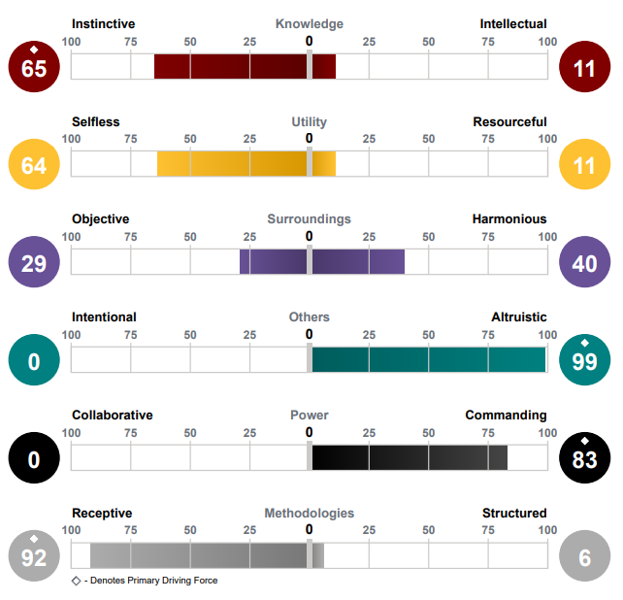

Slide 11
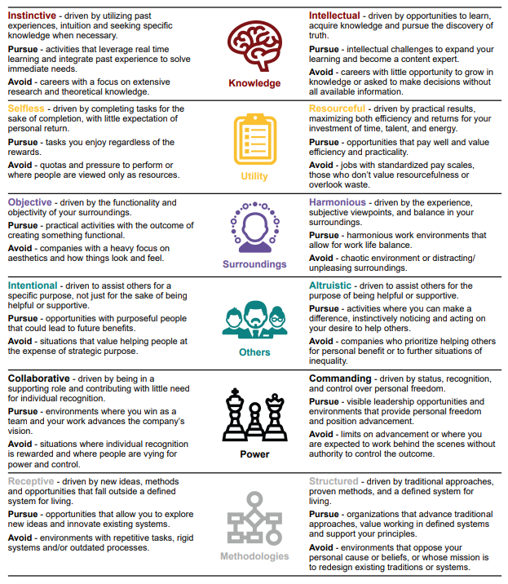

Slide 12
Are you leveraging your strengths?
How do you contribute to teams or groups you are a part of??

Slide 13
Use these skills most.

Slide 14
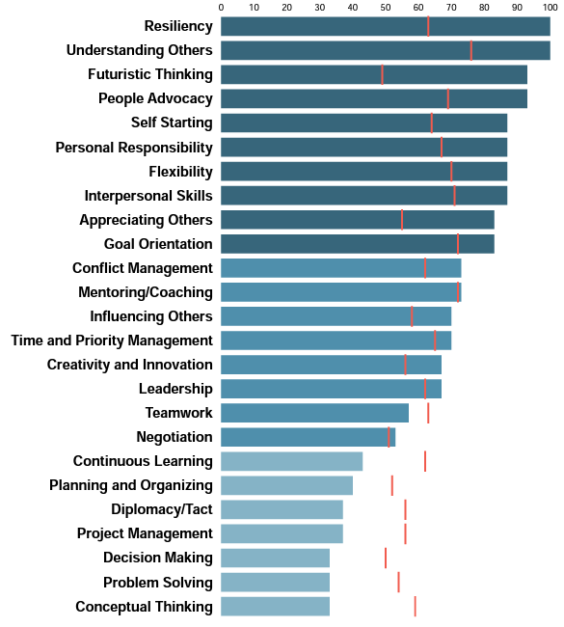
Human Skills.
Skills are learned.
Some are naturally easier/harder for you and…
Brain science proves you can learn any skill!
LESS
Energy Line
MORE

Slide 15
How can I use the information in this report?
Self Reflection – Read through your entire report. Ask yourself questions, stay curious. If you don’t agree, what would you say is true instead?
Working in Teams – How can knowing yourself, your strengths and style help you be the best version of yourself? How can you better understand those you work with?
Resume, Cover Letters, Personal Statements – Use statements that resonate with you and add to them examples of your experiences.

Slide 16
Thank You!

Slide 17
Contact Information
www.IndigoEducationCompany.com
sueann.casey@indigoproject.org
www.linkedin.com/in/sueann-casey-indigo
509-435-5903

