Slide 1
SKILLS/COMPETENCIES TRAINING
rev Jan 2023

Slide 2
SKILLS/COMPETENCIES
Human Skills – Experiential Skills
Employability Skills – Durable Skills
Likert Scale Questionnaire.
Where we are likely to see the most change.

Slide 3
BRAIN SCIENCE OF LEARNING
Our brains are made up of Neurons aka nerve cells and these are the key to learning and retaining knowledge.
Dendrites extend off the cell body. The more we learn about this subject, the more dendrites we develop.
New dendrites connect to Axions of other neurons allowing you to learn something new.
In order to learn something new, we must first start with something we already know and reach out those dendrites to connect to a new idea, concept, skill, etc.

Slide 4
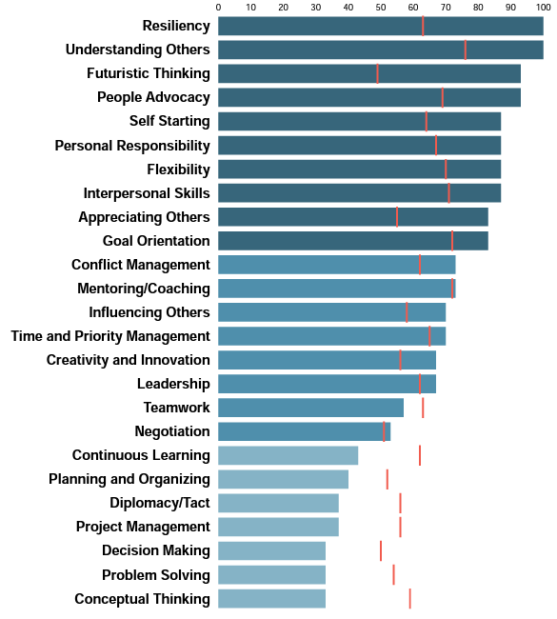
LESS
Focus on top 5 skills
Skills are learned.
Some are naturally easier/harder for you and…
Brain science proves you can learn any skill!
Energy Line
MORE

Slide 5
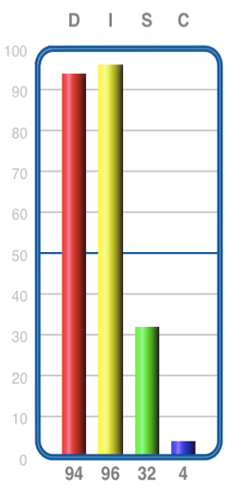
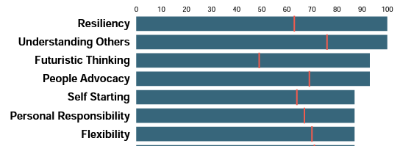
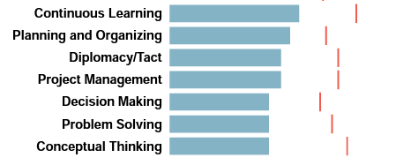
RELATIONSHIP
BETWEEN SKILLS AND DISC
What connections do you see between DISC and the top skills?
What connections do you see between DISC and the bottom skills?
How can we use the top skills to develop any of the bottom skills?

Slide 6
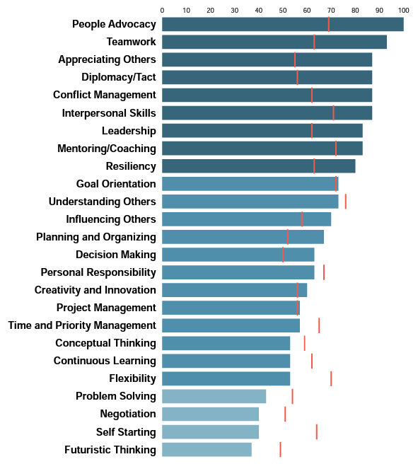
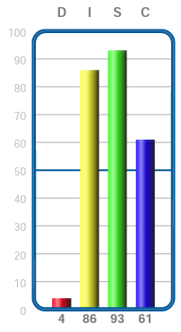
ANOTHER EXAMPLE

Slide 7
Reflection based application
Questions you can present to students for discussion and reflection in class or online.
Skills to grow- Take a look at your bottom 5 skills. As you consider your current job role, or the job you want to obtain next, are there any here that you will need to use frequently? How can you focus on learning, using and practicing this skill over your MBA experience?
Leveraging Top Skills- Take a look at your top 5 skills. How can you focus on practicing and growing these over your MBA experience?
FOR INSTRUCTORS: Now that you have completed watching this training series, you can take this reflection assessment to obtain your Indigo Certification Level 1.

Slide 8
Contact Information
www.IndigoEducationCompany.com
sueann.casey@indigoproject.org
www.linkedin.com/in/sueann-casey-indigo
509-435-5903

